Slide 1


Internship at KPMG
As a Data-Analyst in Lighthouse department
(13th January,2022 – 10th July,2022)

Slide 2
COMPUTER SCIENCE and ENGINEERING DEPARTMENT NIT JALANDHAR
Presented By: Sanyamdeep Singh(18103083)
Submitted To: Dr. Urvashi

Slide 3
Contents
About the Company
Training Summary
List of Courses/Tech Stack
Microsoft Certifications
Capstone Project
Forage Tasks

Slide 4
About the company
KPMG is British-Dutch company and is one of the Big Four accounting firms in the world.
KPMG in India is one of the leading providers of risk, financial and business advisory, tax and regulatory services, internal audit, and corporate governance.
KPMG Lighthouse is the centre of Excellence for data-driven technology. The Lighthouse department deals with data analytics , business intelligence , data engineering , artificial intelligence and machine learning.

Slide 5
Training Summary
Completed some Linked In Learning courses in first 2 weeks
Training by Cloudthat started in first week of February and ended on 23rd April in which all courses were related to azure data engineering.
After the completion of training we were supposed to get certifications done .
Then a hands on Capstone Project where we have to apply all our learnings.
Data engineers are responsible for building pipelines, ingesting data from different sources and processing raw data to make it more useful

Slide 6
List of courses covered in training
Azure fundamentals
Data fundamentals
Python
SQL
Spark
Data factory
Azure log analytics
Azure devops
Azure synapse analytics
Azure Databricks

Slide 7
Microsoft certifications
Deadline given : 31st May 2022
To complete 3 certifications
AZ-900 Azure fundamentals
DP-900 Data fundamentals
DP-203 Data engineering

Slide 8
Azure Fundamentals
AZ-900 Microsoft certification
Learnt about cloud computing and services provided by azure
Public , private and hybrid mode of cloud computing
Created an account on azure portal
Azure regions , availability zones , region pairs
Deployed a virtual machine
Azure pricing calculator , azure advisor

Slide 9
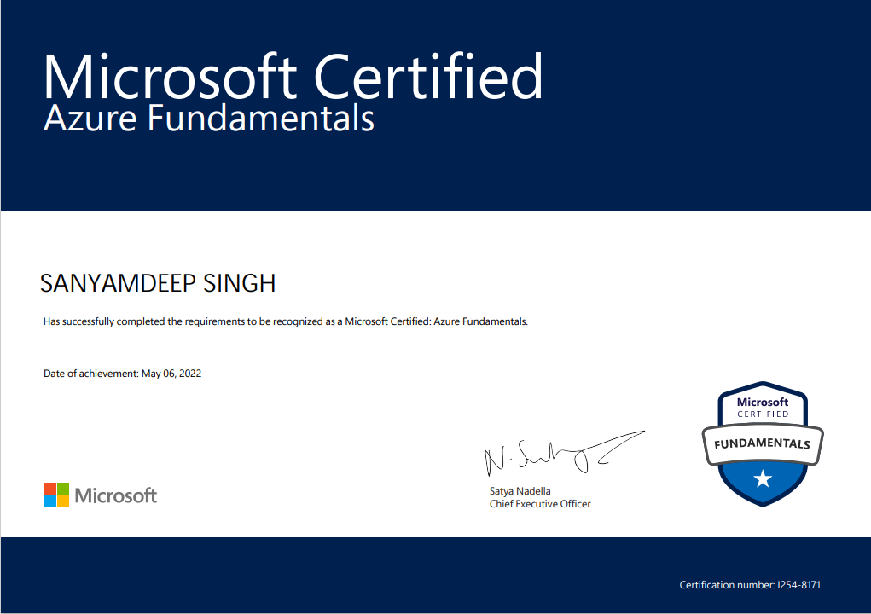
Azure Fundamentals Certification

Slide 10
Data Fundamentals
DP-900 Microsoft certification
What is data and how it is stored?
Relational tables , normalization , SQL to query relational tables
Azure data services are available for MySQL, MariaDB, and PostgreSQL
Azure storage and its types : blob , data lake , files , tables
Data ingestion and pipelines
Batch vs stream data processing

Slide 11
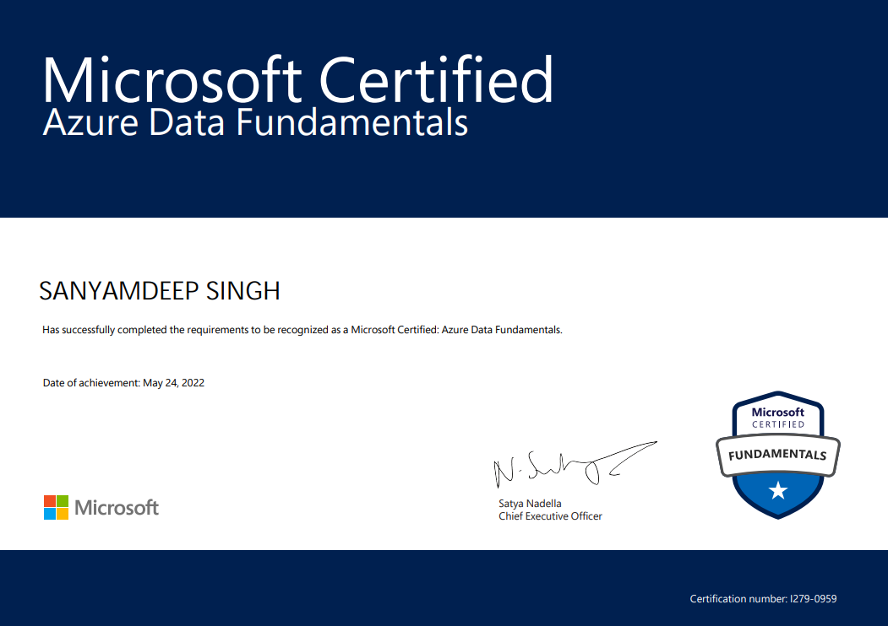
Data Fundamentals Certification

Slide 12
Python
Most commonly used language in data science
We learnt its basics , if conditions , loops , operators
Data structures like list , tuple , dictionaries
Numpy and pandas libraries to deal with arrays and data frames
Exception handling , OOPS

Slide 13
SQL
It stands for standard query language
It is used to store, manipulate and retrieve data from relational databases
How to create , drop and alter tables
How to read , update , insert , delete data in tables
Aggregate functions like SUM, MIN, MAX, COUNT, AVG
Joins and its types : inner , left , right , outer

Slide 14
DP-203 Data engineering on Microsoft azure
Synapse analytics , databricks , data factory are tools used by azure data engineers.
How to ingest data from different sources?
How to perform transformations and make data more useful?
How to build pipelines and trigger them?
How to run notebooks and work with data frames in databricks?

Slide 15
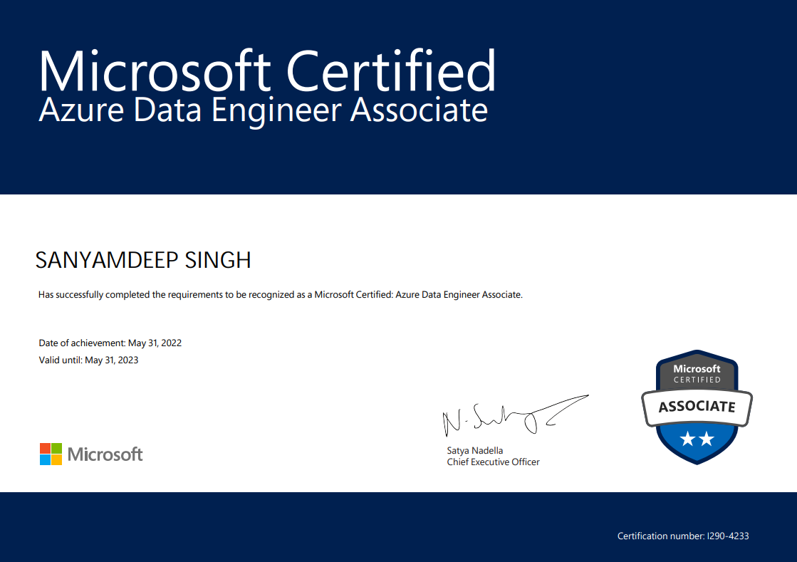
DP-203 Data engineering Certification

Slide 16
Capstone Project-Problem Statement
ABC Health is one of the largest hospital system, with a chain of eleven hospitals, equipped with advanced bio-medical instrumentation and a dedicated staff of 5000+ employees.
The company want to have a dedicated team which can analyze data collected by ECDC Epidemic Intelligence to keep an eye on worldwide COVID trends such as reported cases, mortality rate, hospitalization & ICU admission rates & current occupancy, testing volume and country response which can act as a feedback to improve their existing healthcare processes and patient monitoring system to respond optimally towards COVID.
They came to know about the seamless capabilities of Modern Data Platform Technologies exists within the ecosystem of Microsoft Azure and wants to build an Azure Data Platform to bring insights out of the source mentioned to accelerate the response and services to save lives.

Slide 17
Capstone Project-Understanding Dataset
We were given three sources related to covid : Confirmed cases and mortality rate, Hospitalization and ICU cases, Testing numbers.
We have 4 csv files. The first one cases_deaths.csv has the weekly number of cases and deaths in each country and also the total number of cases and deaths till each week.
The second csv file hospital_admissions.csv contains the day wise daily hospital and ICU occupancy and weekly new hospital & ICU admissions per 100K in each country. We have date, year_week column.

Slide 18
Capstone Project-Understanding Dataset
The third csv file testing.csv contains data like number of tests done and new cases each week in different regions of different countries. It also contains testing rate and positivity rate of each week. There are different regions like Burgenland with region code AT11 in Austria country with country code AT.
The fourth csv file contains data about the responses each country took and on which dates.
We had to come up with a solution using the technologies we had learnt.

Slide 19
INGESTION
The first step of our solution is INGESTION.
Data Ingestion is simply the process of extracting data from multiple sources and accumulating it in a processing environment.
It includes following steps :
Creating Storage account
Creating Data Factory to ingest data
Creating pipelines to ingest data
Ingest data in datalake

Slide 20
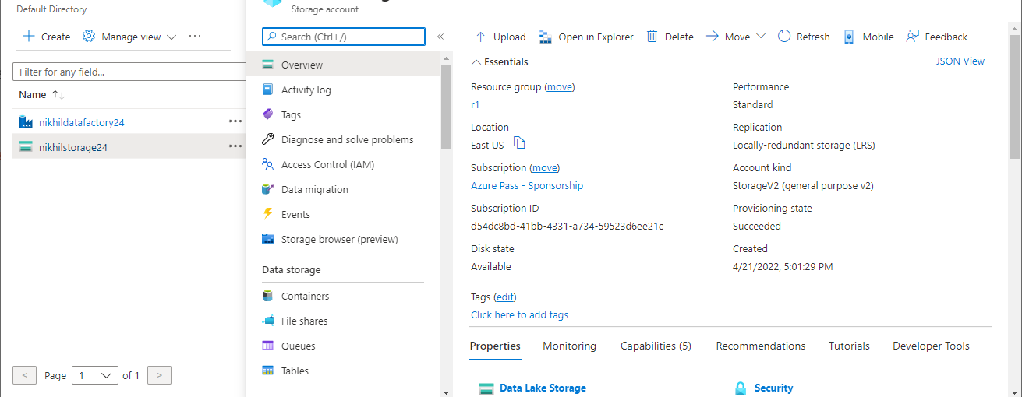
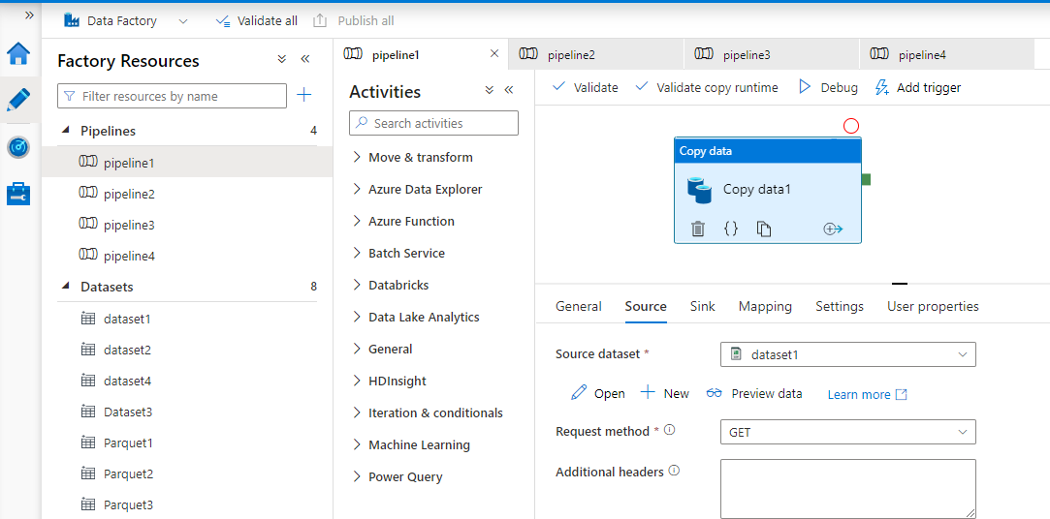
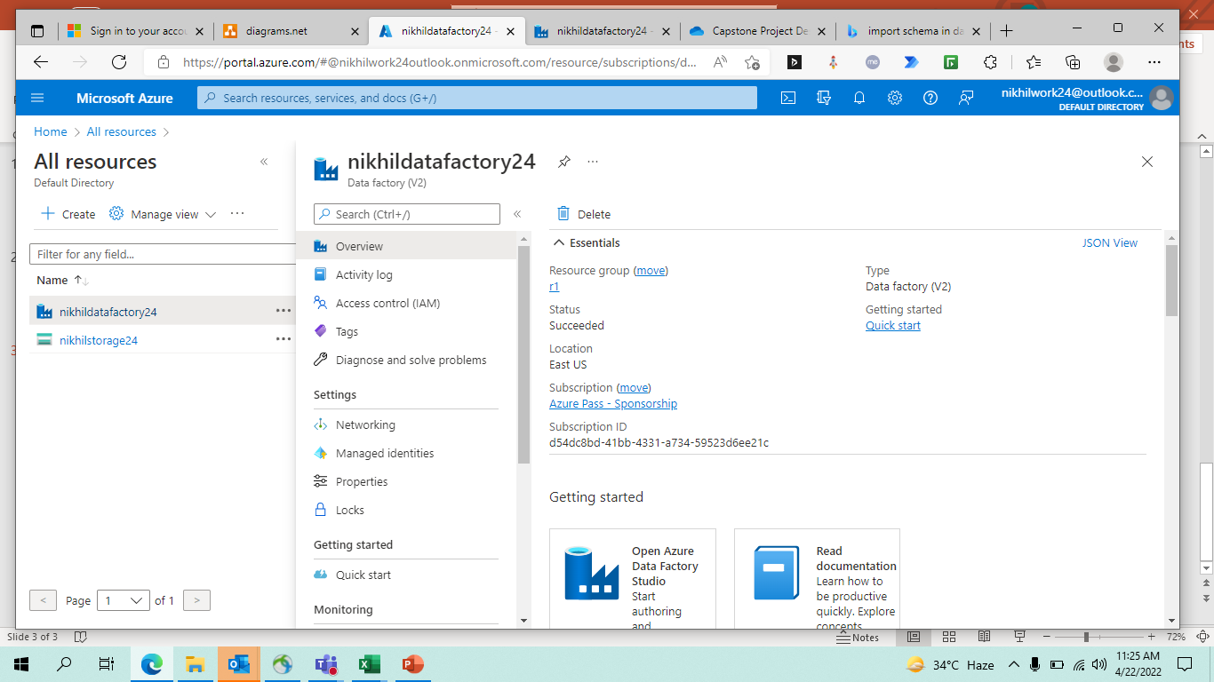
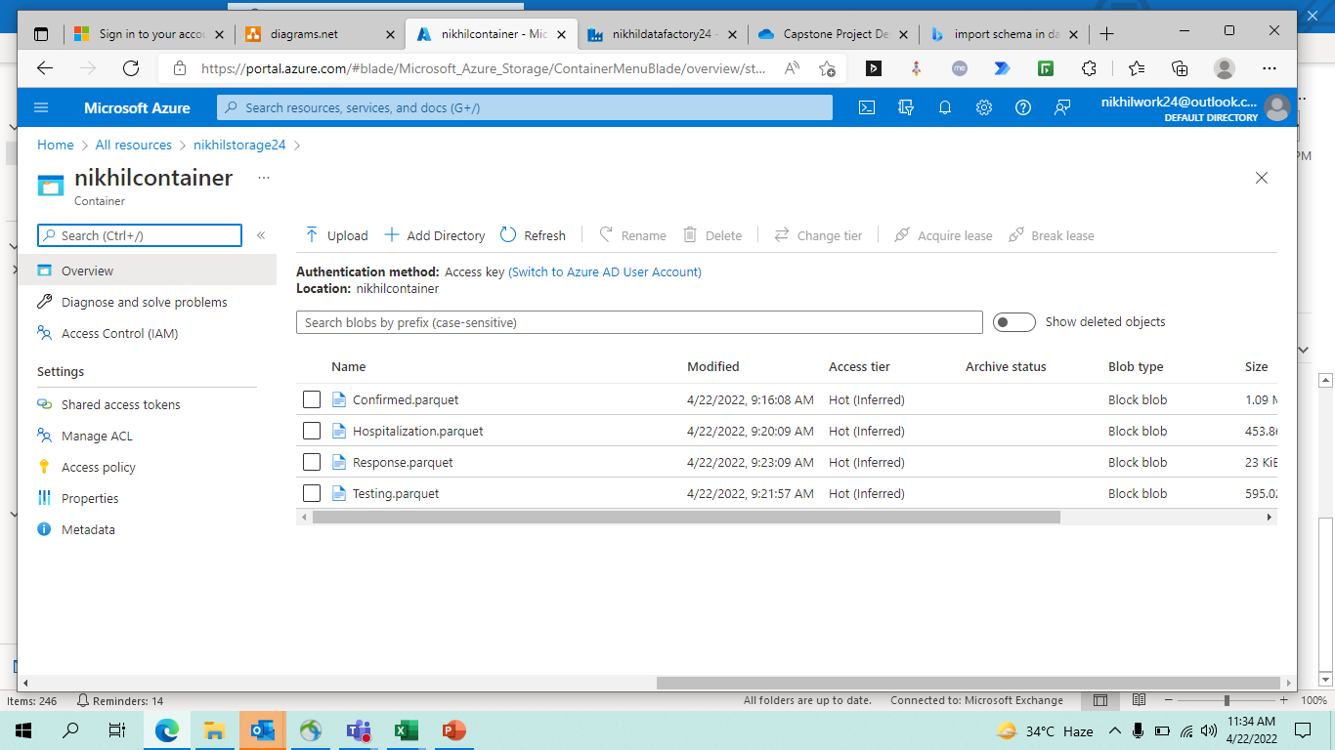
INGESTION

Slide 21
TRANSFORMATION
The next step of our solution is TRANSFORMATION.
Data transformation is the process of converting data from one format to another, typically from the format of a source system into the required format of a destination system
It includes following steps :
Creating Databricks
Creating Spark clusters
Notebooks for quering and modifying data
Processing raw data

Slide 22
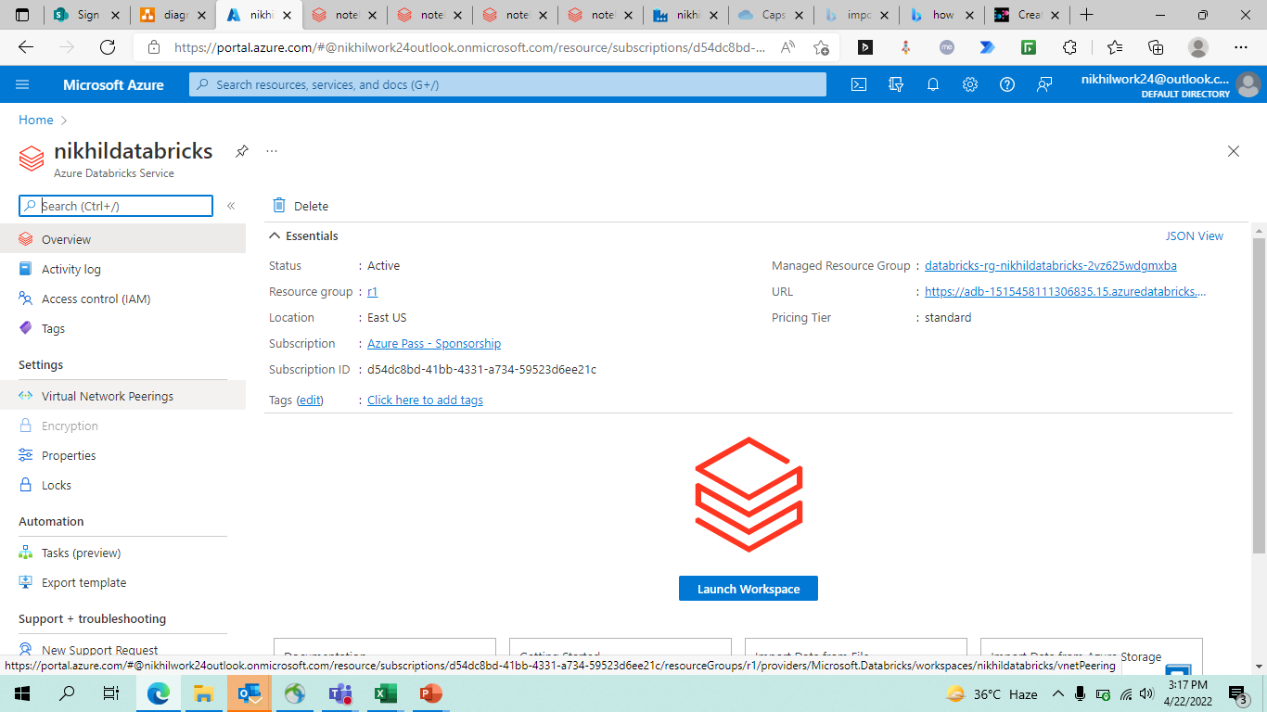
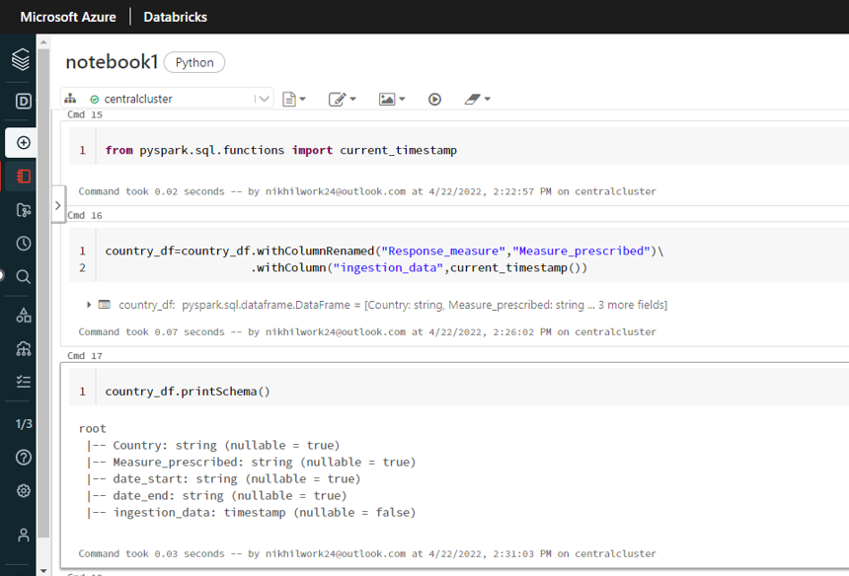
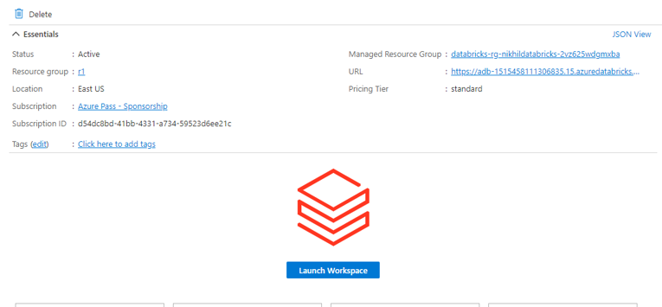
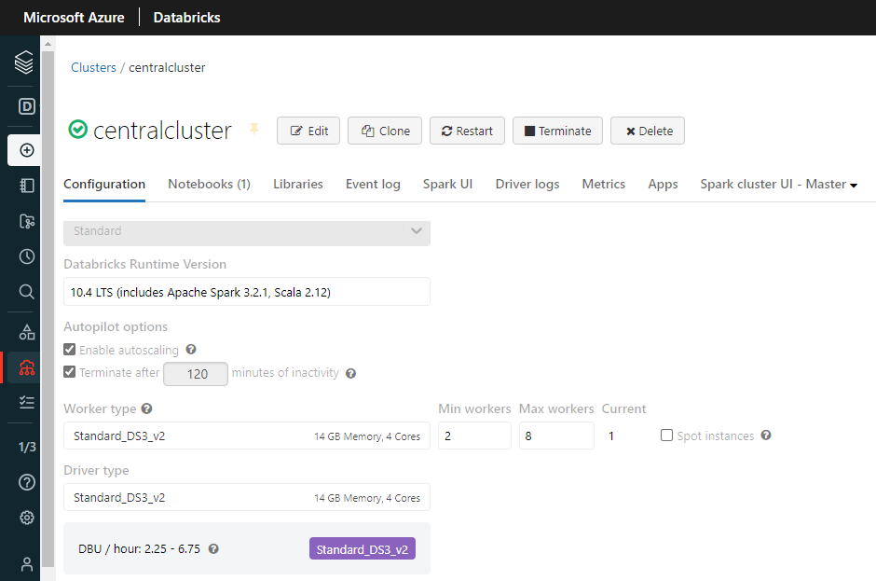
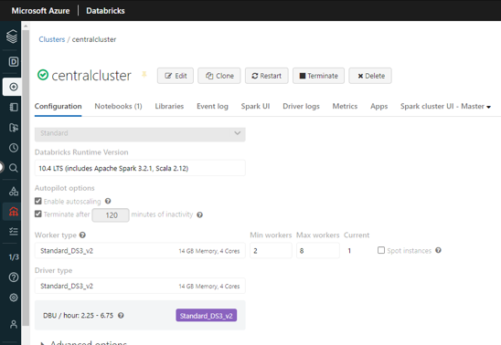
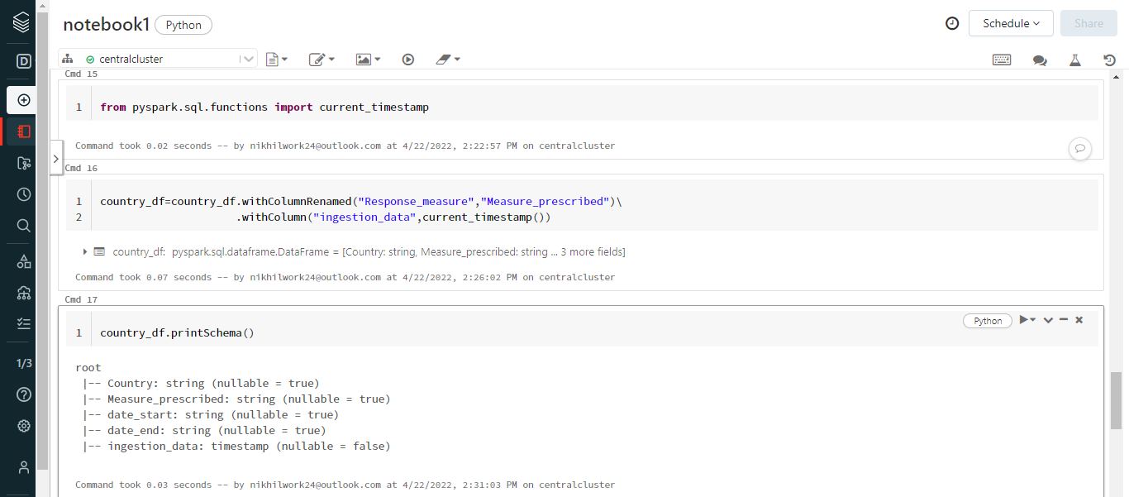
TRANSFORMATION

Slide 23
VISUALISATION
The next step of our solution is VISUALISATION.
Data visualization is the representation of data through use of common graphics, such as charts, plots, infographics, and even animations.
These visual displays of information communicate complex data relationships and data-driven insights in a way that is easy to understand.

Slide 24
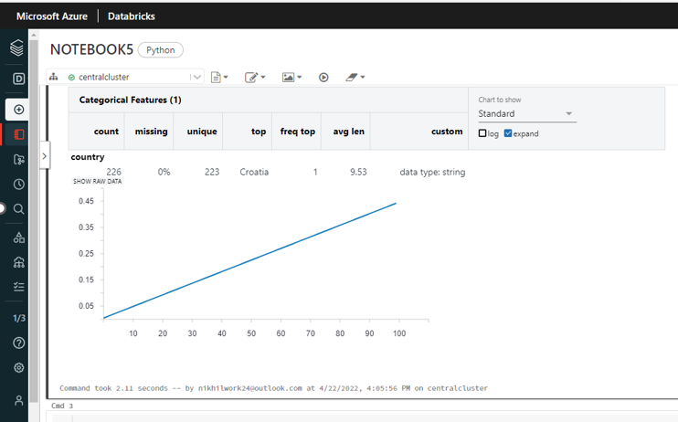
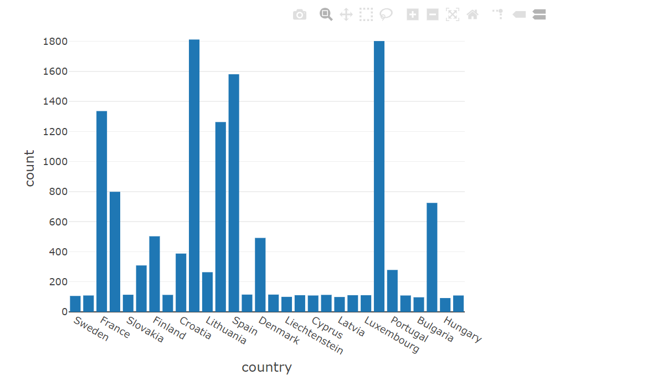
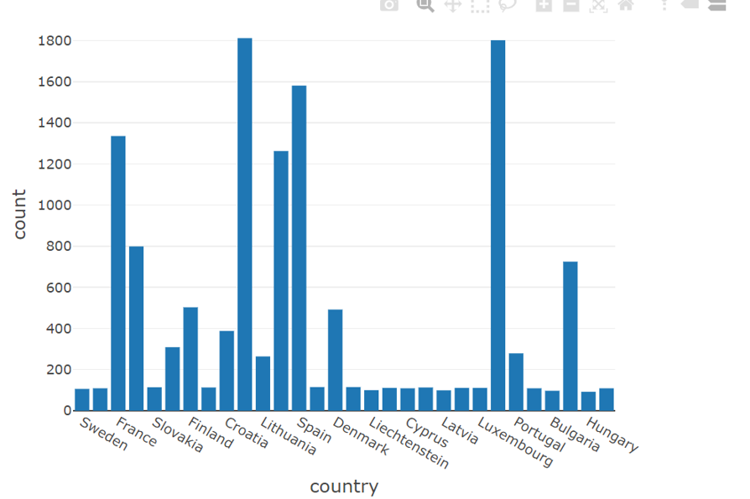
VISUALISATION

Slide 25
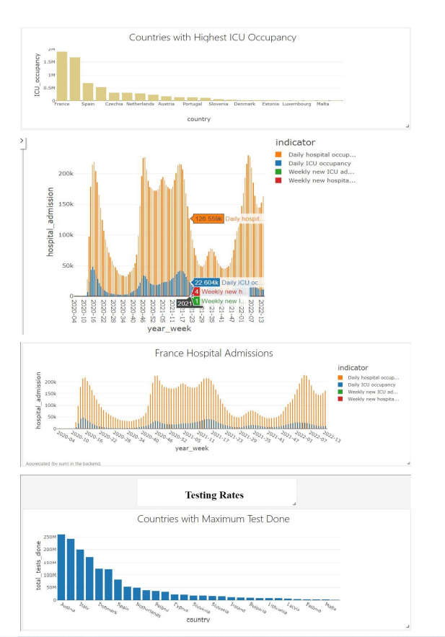
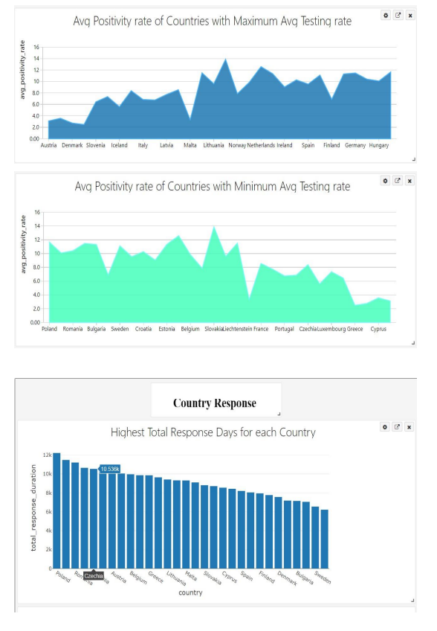
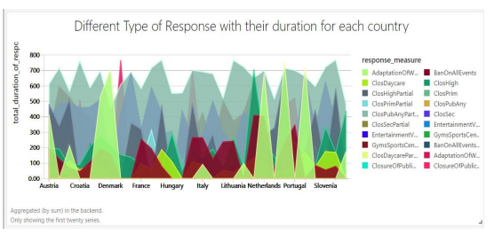
VISUALISATION

Slide 26
Forage Tasks
Forage is the platform where we have to submit tasks on a weekly basis.
Tasks are non-technical related to consulting.
Not related to data engineering
The first task was Gathering insights through client interviews in which we did research about why Zomato’s market share reduced.
We did competitive analysis with Swiggy and prepared questionnaire for Zomato team to find out reasons of the same.

Slide 27
Thank You

